Slide 1
Web Application Development Concepts
Java, Maven, Spring IoC/DI, Spring Data JPA, Spring MVC, Spring REST

Slide 2
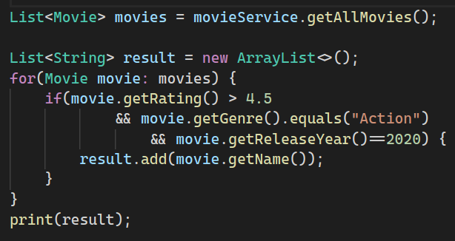
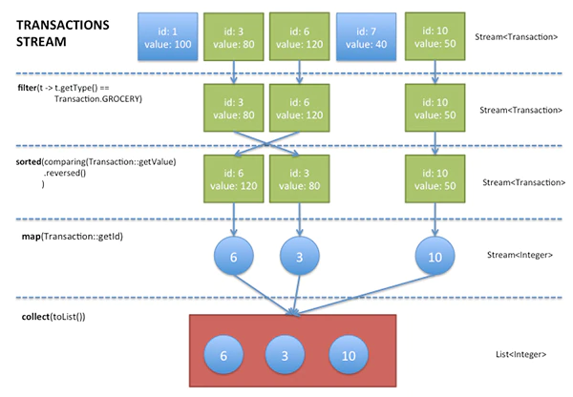
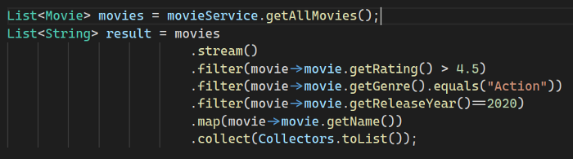
Functional Programming with Lambdas
https://medium.com/@ashaythecoder/part-c-entering-in-stream-world-f943eb3c4f0d
https://www.oracle.com/technical-resources/articles/java/ma14-java-se-8-streams.html

Slide 3
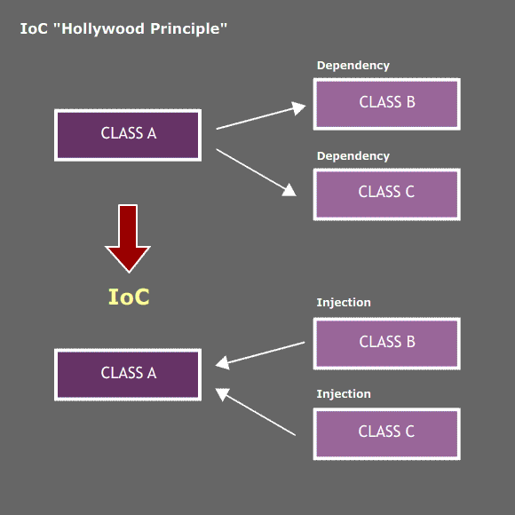
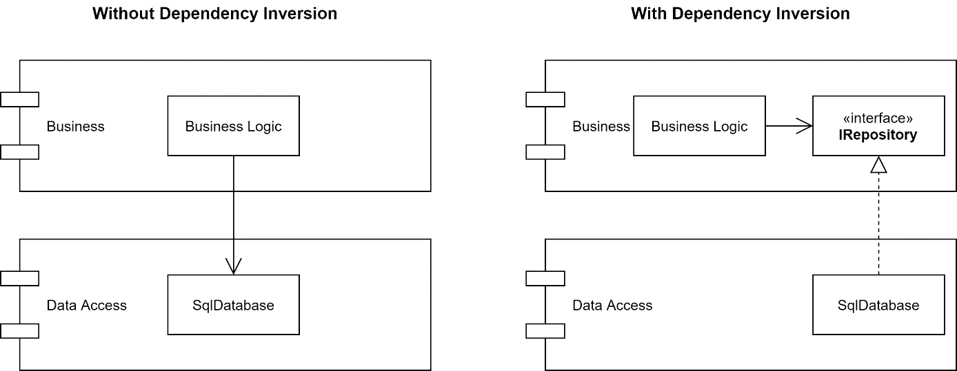
Spring IoC / DI
Create an “API” in 15 minutes
https://medium.com/analytics-vidhya/dependency-injection-concept-of-spring-framework-d9c3688005f8

Slide 4
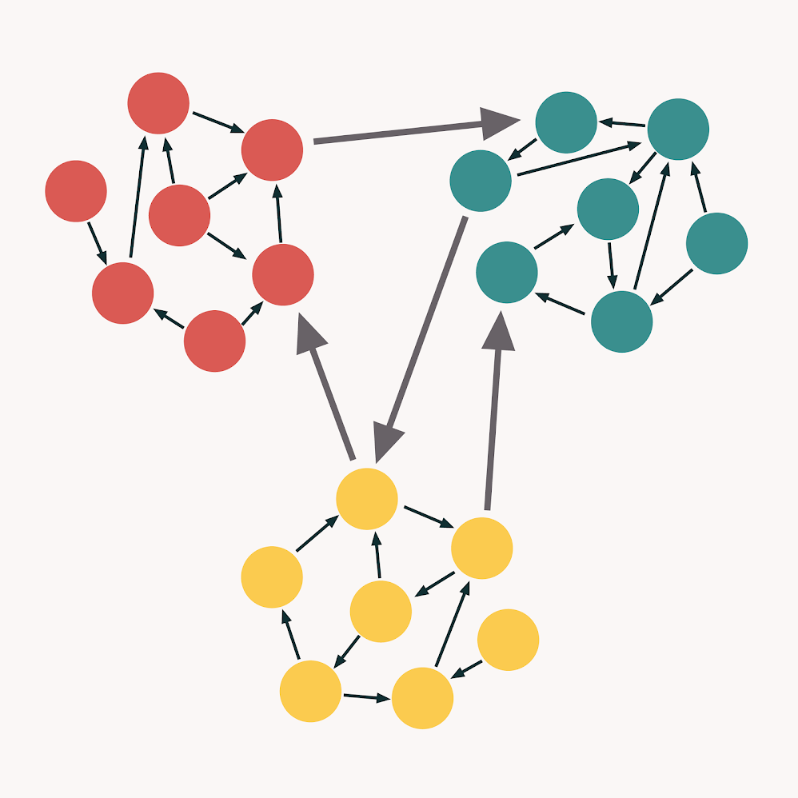
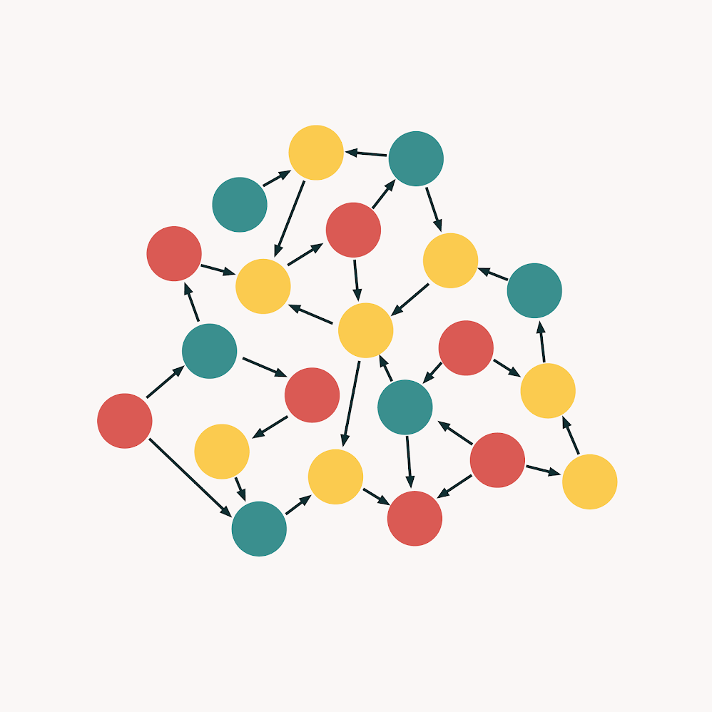
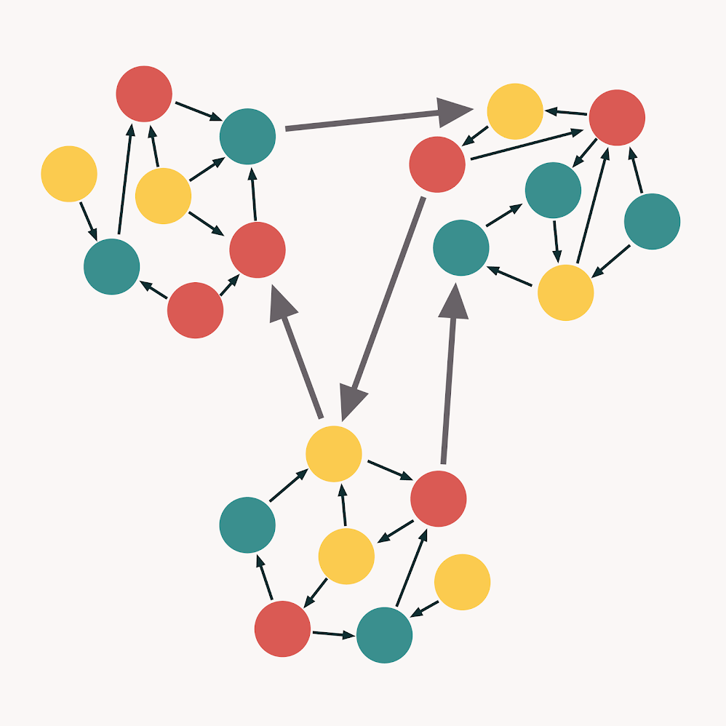
High Cohesion, Low Coupling
https://enterprisecraftsmanship.com/posts/cohesion-coupling-difference/

Slide 5
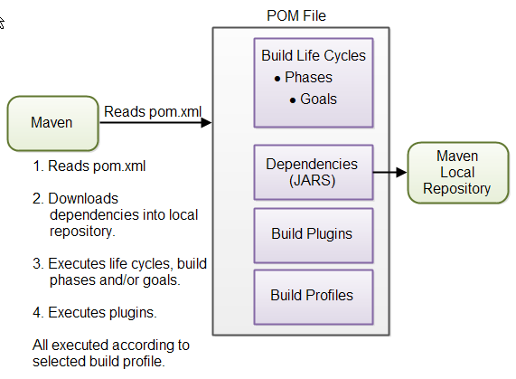
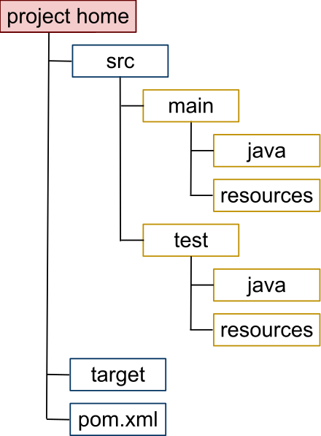
Maven Dependency Management
https://en.wikipedia.org/wiki/Apache_Maven
http://tutorials.jenkov.com/maven/maven-tutorial.html

Slide 6
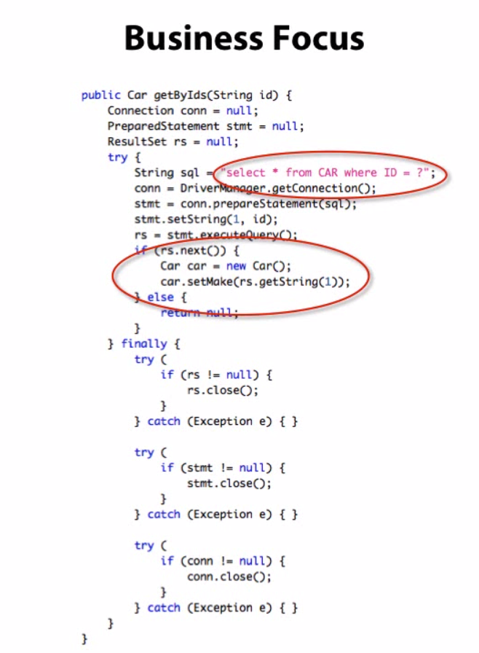
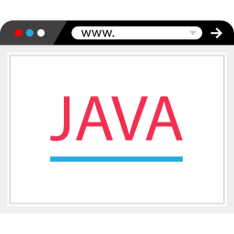

Spring Data JPA
JDBC
Hibernate
object-relational mapping (ORM) to be implemented by hand
ORM is done automatically, but DAO remains to be implemented by hand
must be implemented manually
Towards more Business Logic
Hibernate
+
Spring Data JPA
ORM does it automatically: DAO is implemented automatically
DAO prêt à l’emploi

Slide 7
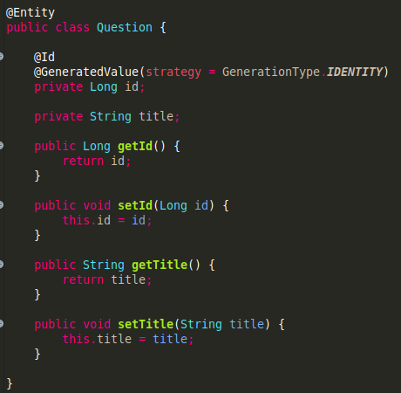





JPA
JPA (Java Persistence API)
Set of Standards
Entities
Repository (DAO)
Purpose: correspondence between the Java object and the SQL table
Purpose: methods for CRUD operations
save()
findById()
findAll()
delete()
...
Standards & Specifications
Hibernate
Spring Data JPA

Slide 8
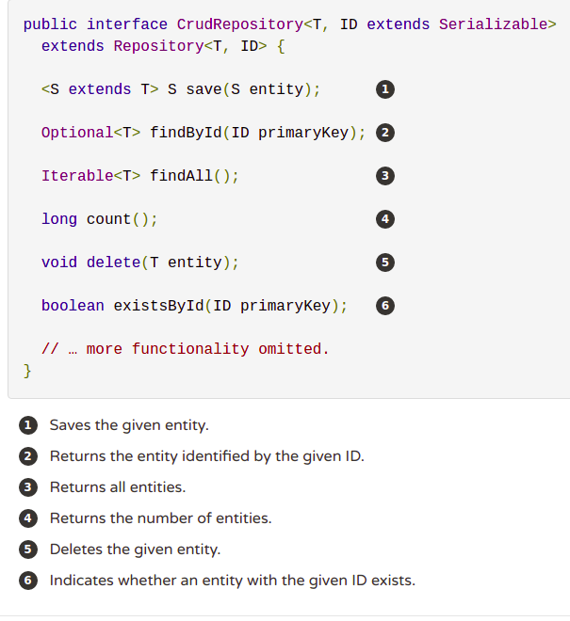
Spring Data JPA
Interfaces
CrudRepository
PagingAndSortingRepository
One repository to rule them all
JpaRepository

Slide 9

Spring Data JPA
Project Architecture
JpaRepository
(Repository)
Wilder
(Entity)
WilderRepository
Create an “API” in 15 minutes
WilderController

Slide 10
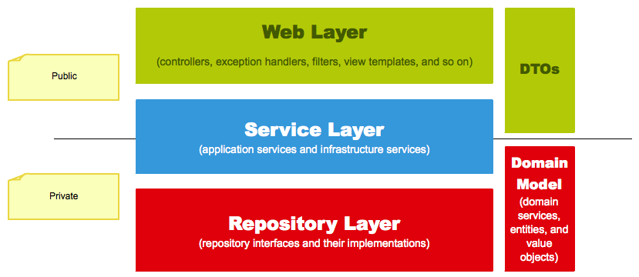
Layered Architecture
https://www.petrikainulainen.net/software-development/design/understanding-spring-web-application-architecture-the-classic-way/

Slide 11
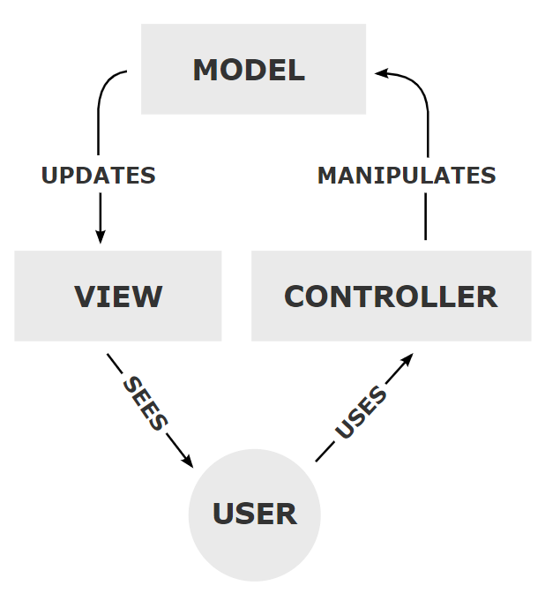
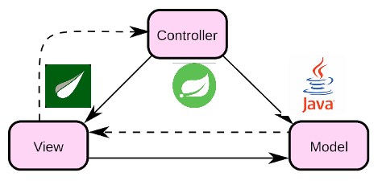
Model-View-Controller (MVC)
https://en.wikipedia.org/wiki/Model%E2%80%93view%E2%80%93controller
https://agile-coding.blogspot.com/2020/10/spring-mvc-thymeleaf.html

Slide 12
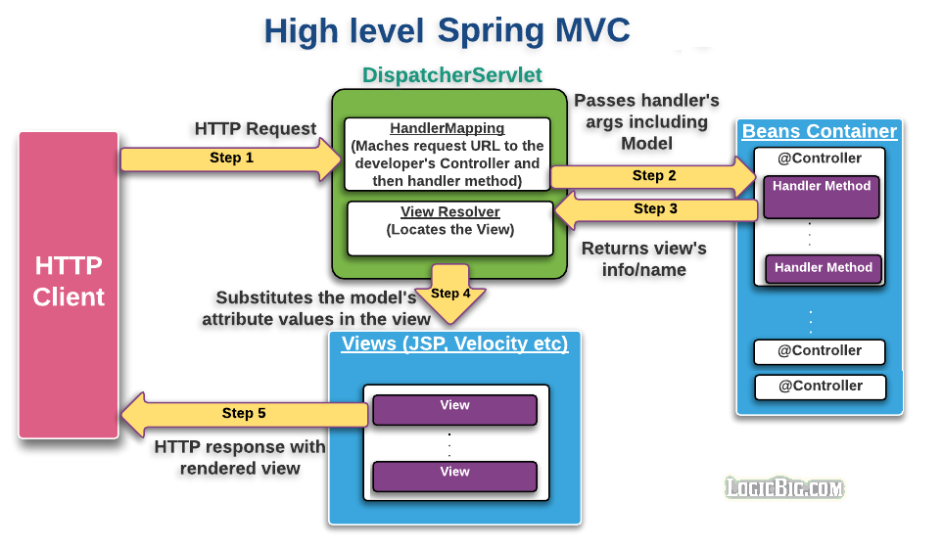
Spring MVC
https://www.logicbig.com/tutorials/spring-framework/spring-web-mvc/spring-mvc-intro.html

Slide 13
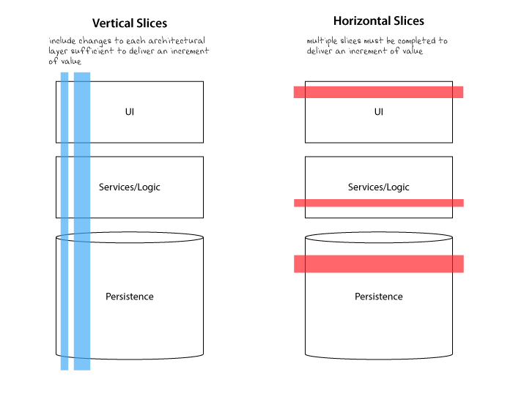
Modelling: Layers vs Slices
+- example (Layer)
|
+- controller
| +- ProductController.java
| +- OrderController.java
| +- CustomerController.java
|
+- dao
| +- ProductRepository.java
| +- OrderRepository.java
| +- CustomerRepository.java
+- example (Slices)
|
+- product
| +- ProductController.java
| +- ProductService.java
| +- ProductRepository.java
|
+- order
+- OrderController.java
+- OrderService.java
+- OrderRepository.java
https://www.humanizingwork.com/vertical-slices-and-scale/
https://frontbackend.com/spring-boot/what-code-structure-use-for-spring-boot-applications

Slide 14
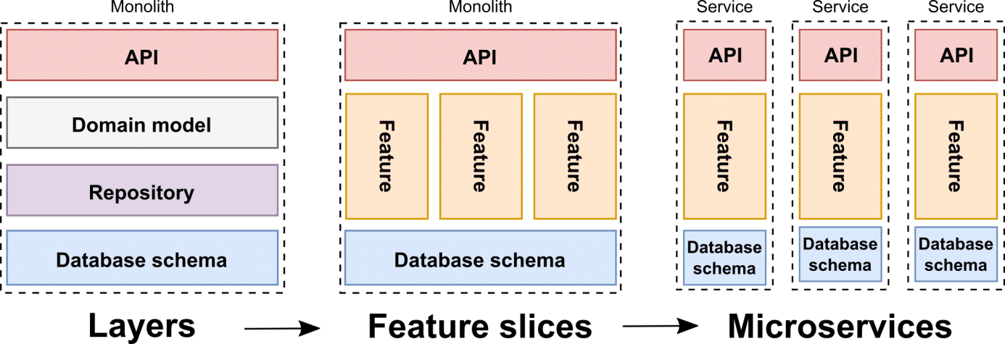
Modelling: Layers vs Slices (Monolith vs Microservices)
https://www.humanizingwork.com/vertical-slices-and-scale/
https://frontbackend.com/spring-boot/what-code-structure-use-for-spring-boot-applications

Slide 15
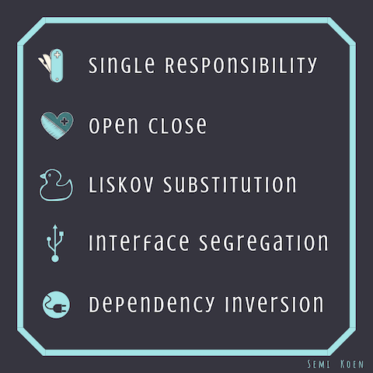
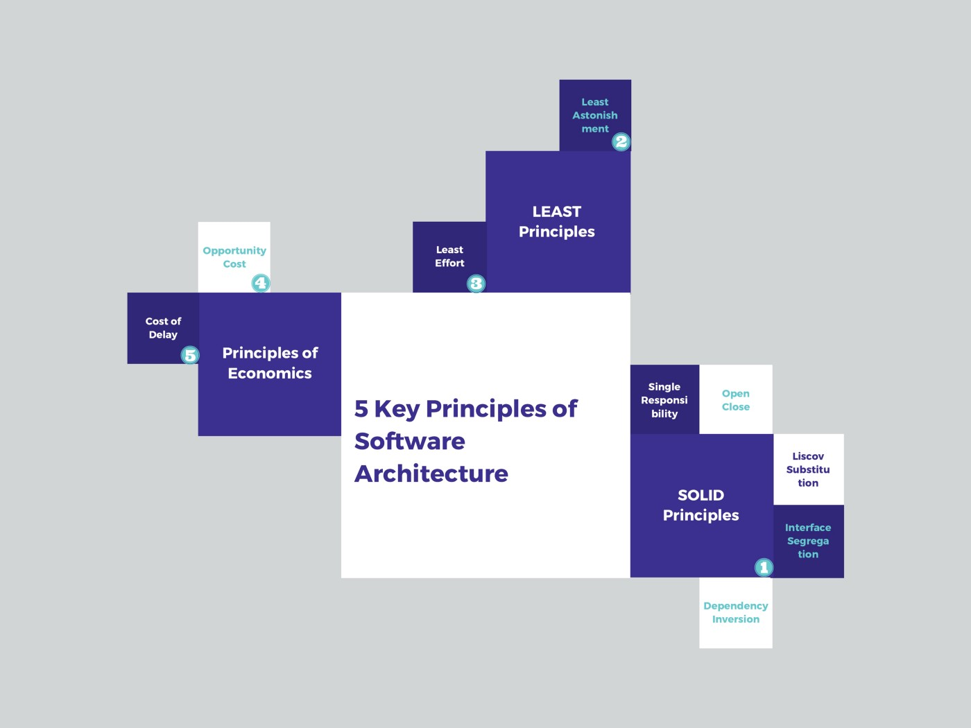
SOLID
https://towardsdatascience.com/5-key-principles-of-software-architecture-e5379cb10fd5

Slide 16
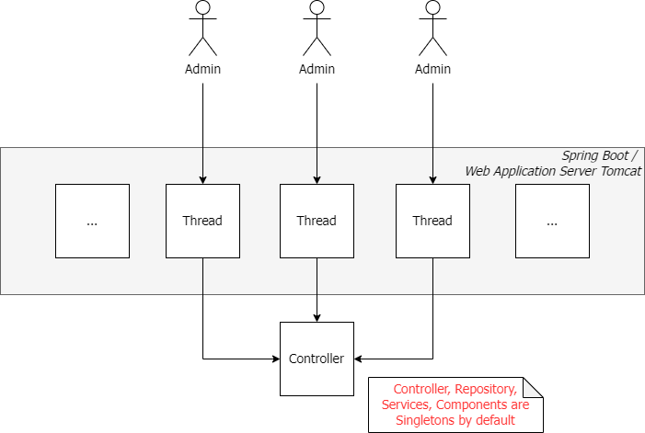
Multithreading & Singletons
Be very careful about Singletons!
Per default, all beans in Spring are Singletons, this is ok:
...if the beans are of technical nature (Controller, Repository)
...if there is no state involved (no member attributes in the class)
...if the classes are thread-safe
For example JPA Entities should never be Singletons!

Slide 17
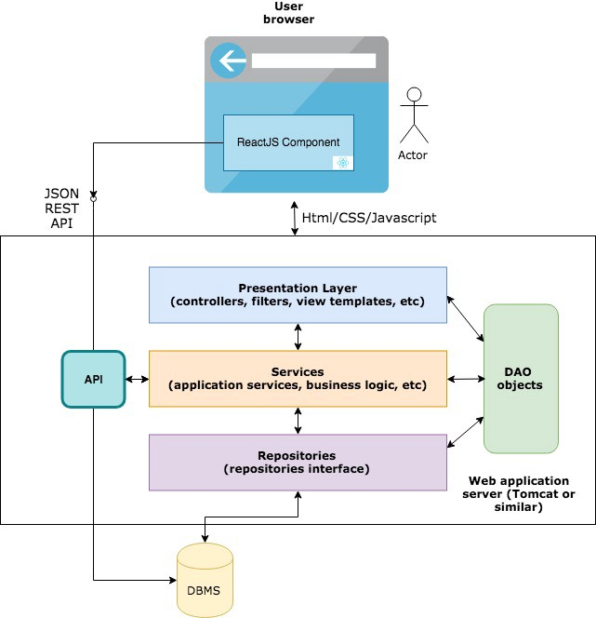
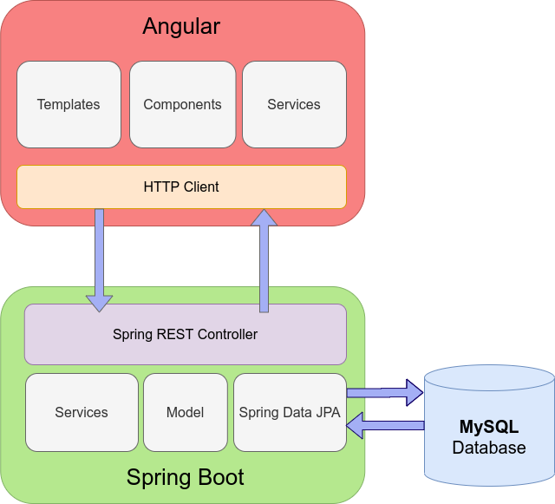
REST
https://medium.com/swlh/moving-from-java-spring-framework-to-a-reactjs-apis-architecture-dd85787cc616
https://frontbackend.com/spring-boot/angular-11-spring-boot-2-mysql

Slide 18
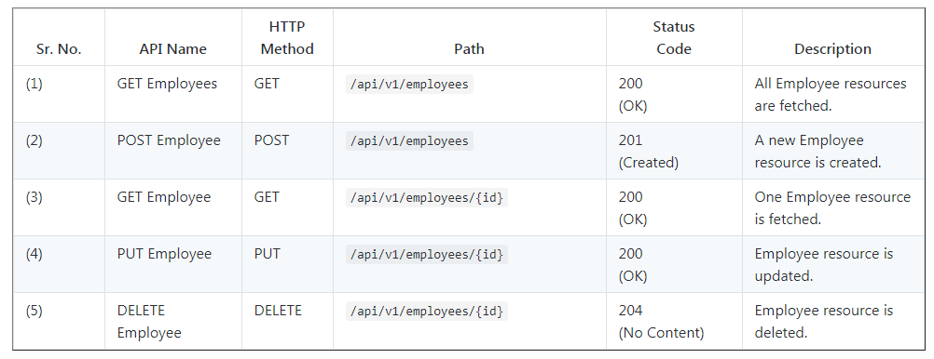
REST HTTP Methods (Verbs)

